Slide 1
Machine Learning
Reinforcement Learning model for BLACKJACK
Name: Arka Pramanik
Reg No: 20BCE0447

Slide 2
Reinforcement Learning model for BLACKJACK
01
What is BLACKJACK?
04
SARSA
02
Reinforcement Learning
Temporal Difference
05
03
MONTE CARLO
06
Comparison and Conclusion

Slide 3
WHAT IS BLACKJACK?
Blackjack is a popular casino card game where the objective is to have a hand value of 21 or as close to it as possible without exceeding it. In Blackjack, each player plays against the dealer and not against other players.
From a reinforcement learning perspective, Blackjack is an interesting game because it involves making decisions based on incomplete information. The player can see their own cards and one of the dealer's cards, but not the second card that the dealer has face down. This means that the player must make decisions based on the probability that the hidden card is of a certain value.
Reinforcement learning algorithms can be used to teach a computer program how to play Blackjack optimally by maximizing the expected reward over time. The program can learn how to make the best decision based on the current state of the game, taking into consideration the player's hand, the dealer's up card, and any other relevant information.

Slide 4
BLACKJACK- GAME MECHANICS
The game begins with two cards dealt to both dealer and player. One of the dealer’s cards is face up and the other is face down. If the player has 21 immediately (an ace and a 10-card), it is called a natural. He then wins unless the dealer also has a natural, in which case the game is a draw. If the player does not have a natural, then he can request additional cards, one by one (hits), until he either stops (sticks) or exceeds 21 (goes bust). If he goes bust, he loses; if he sticks, then it becomes the dealer’s turn. The dealer hits or sticks according to a fixed strategy without choice: he sticks on any sum of 17 or greater, and hits otherwise. If the dealer goes bust, then the player wins; otherwise, the outcome — win, lose, or draw — is determined by whose final sum is closer to 21.If the player holds an ace that he could count as 11 without going bust, then the ace is said to be usable.

Slide 5

REINFORCEMENT LEARNING
Reinforcement Learning is a machine learning method, which is based on rewarding desired actions/output and punishing for the undesired ones. Reinforcement learning models are choosing which action to make based on the expected return of each action. Model takes some information about the current situation and possible actions as input, then you must reward it based on the decision that it decides to make. Reinforcement learning models learn to perform a task through repeated trial-and-error interactions with an environment and do so without any human intervention.

Slide 6
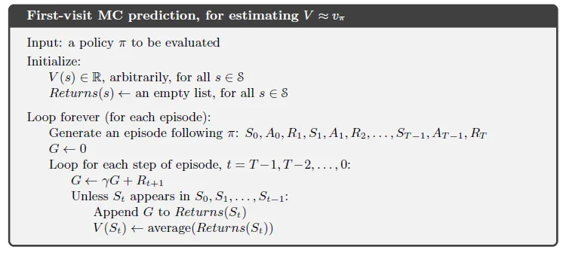
MONTE CARLO
The term Monte Carlo is usually used to describe any estimation approach relying on random sampling. In other words, we do not assume of knowledge of our environment, but instead only learn from experience, through sample sequences of states, actions, and rewards obtained from interactions with the environment.These methods work by directly observing the rewards returned by the model during normal operation to judge the average value of its states.

Slide 7
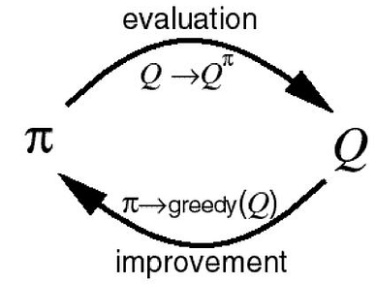
MONTE CARLO
In order to construct better policies, we need to first be able to evaluate any policy. If an agent follows a policy for many episodes, using Monte-Carlo Prediction, we can construct the Q-table (i.e. “estimate” the action-value function ) from the results from these episodes.
We start with a stochastic policy and compute the Q-table using MC prediction. So we now have the knowledge of which actions in which states are better than other i.e. they have greater Q-values. So we can improve upon our existing policy by just greedily choosing the best action at each state as per our knowledge i.e. Q-table and then recompute the Q-table and chose next policy greedily and so on.
But we have a problem, what if for a state ‘St’ there were 2 actions ‘stick’ and ‘hit’ what if agent chooses ‘hit’ early on in the many games the agent will play and wins whereas ‘stick’ should’ve been the better action, it never got to explore the action as the algorithm went on greedily choosing it multiple times. Thus to solve this exploration-exploitation dilemma, we’ll use ε-greedy policy i.e. we’ll explore, take a random action with probability ‘ε’ (epsilon) rather than greedily exploiting the learnt Q-values. Naturally we’d like to keep the ε values ~1 at the start and reduce it till close to 0 by the end of the learning (total no. of episodes).

Slide 8
SARSA (State–action–reward–state–action)
SARSA (State-Action-Reward-State-Action) is a reinforcement learning algorithm that uses the on-policy approach, meaning it learns the optimal policy while following the same policy. In the context of Blackjack, SARSA can be used to train an agent to make decisions about whether to hit or stick based on its current hand and the dealer's visible card.
In SARSA, the agent updates its Q-values based on the current state, action taken, reward received, next state, and next action. The Q-value represents the expected long-term reward for taking a specific action in a given state. By updating the Q-values based on the observed rewards, the agent learns which actions are more likely to lead to a favorable outcome.
To apply SARSA to Blackjack, the agent starts with a random policy and plays multiple episodes of the game, observing the rewards obtained at each step. It then updates its Q-values using the SARSA update rule, which takes into account the current state, action, reward, and the next state and action. Over time, the agent learns to make better decisions based on its experience and the updated Q-values.

Slide 9
TEMPORAL DIFFERENCE
Temporal Difference (TD) learning is another reinforcement learning algorithm that can be applied to the game of Blackjack. TD learning is a model-free, on-policy algorithm that updates the value function for a given state based on the difference between the predicted value and the actual reward received.
In the context of Blackjack, TD learning can be used to learn the optimal policy for when to hit or stand based on the current hand and the dealer's visible card. The agent starts by initializing the Q-values for each state-action pair to some initial value. Then, as it plays multiple episodes of the game, it updates the Q-values for each state-action pair using the TD update rule.
The TD update rule consists of computing the temporal difference error, which is the difference between the current estimated value of a state-action pair and the sum of the immediate reward and the discounted value of the next state-action pair. The agent then updates the Q-value for the current state-action pair using the temporal difference error and a learning rate, which determines how much weight to give to new experiences versus past experiences.
Over time, the agent learns the optimal policy for playing Blackjack by updating its Q-values based on its experience of playing the game. This allows the agent to make better decisions about whether to hit or stand based on the current state of the game.

Slide 10
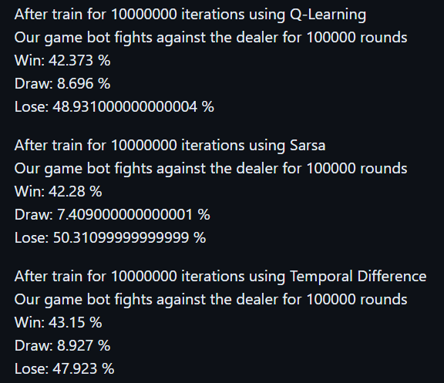
CONCLUSION
SARSA is an on-policy temporal difference algorithm, and Q-Learning is an off-policy Temporal Difference(TD) prediction method. Both SARSA and Q-learning update the Q-value after every time step; however, Q-Learning maximizes the state-action value function(Q-value) over all possible actions for the next steps, and SARSA samples its next action based on the policy it is learning. Both SARSA and Q-Learning both use the epsilon greedy policy. SARSA uses Bellman equation to learn a near-optimal policy whereas Q-Leaning uses Bellman optimality equation to learn an optimal policy.

Slide 11
THANK YOU

